Slide 1
APUSH Review: The Encomienda System
Everything You Need To Know About The Encomienda System To Succeed In APUSH

Slide 2
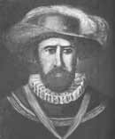
Background Info
Early 16th century
Spanish system of control over Natives in much of the Americas
What did it do?
Royal grants of land from the Spanish Crown to Spaniards
In return, the Spanish promised to Christianize the Natives living on the land
Spanish gained tribute from the Natives
How were Natives affected?
Most were treated harshly
Heavy manual labor – building roads and infrastructure
Encomiendas became wealthy due to the discovery of gold and silver
Nicolás de Ovando

Slide 3

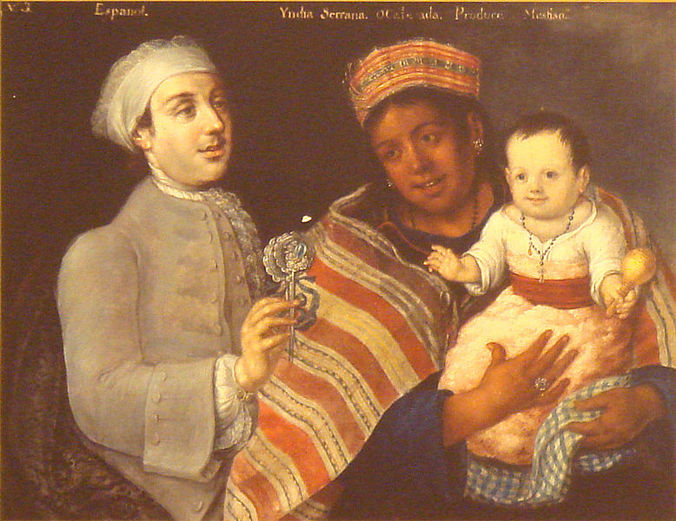
Downfall of the Encomienda System
Many Catholics began to protest the harsh treatment of the Natives
Mestizos (individuals of Spanish and Native Ancestry) could not be forced to work the encomienda system
In time, this helped lead to the decline of the system
Gradually, the system was replaced by African slave labor, like many areas of the Americas
Bartolomé de las Casas

Slide 4
Test Tips
Multiple-Choice Questions and Short Answer:
Encomienda system was Indian slave labor by another name
Gradually replaced by African slave labor
Essay Questions:
Not likely since it’s from the first time period

